Slide 1
Selling Ames Revisted
A further investigation of the local housing market of Ames, IA

Slide 2
Ames Itself:
Ames, Iowa remains a “land of real estate opportunity.”
With nearby Iowa State University, there is opportunity for short-term rentals, such as the housing needed for ~20,000 upperclassmen, as well as the influx of recently graduated students.
The market conditions, in turn, are close to a perfect split for favoring buyers and sellers, making the data easier to assess, but with a minor break for sellers, for good potential return on investment.
Combine all of this with a mean housing price of $177,361, almost $20,000 below the $197,100 Opportunity to sell for a good price at a relatively low cost of entry.
Ames is stable in population, but has grown substantially over the last 30 years, with another increase in the last 3.
With that in mind, the question becomes one of how the speculator can best sell to prospective landlords, new residents, or those looking to upgrade?

Slide 3
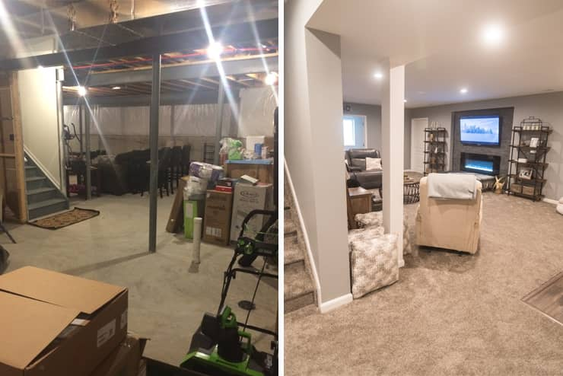
Data Modeling and the Housing Market
There are many similarities and differences that might play into the price of a house.
Some are fairly obvious. Larger houses with fewer problems naturally sell for more, for example.
Certain features also drive the price upward.

Slide 5
Assumptions
Depending on your inclination to flip a property vs. use it as a rental, there are a few additional assumptions to be made.
Namely, certain aspects such as proximity to Iowa State University (no more than a 35 minute drive from campus for landlords), as well as at least four bedrooms and bathrooms, to maximize rental income.
For those hoping to flip and those hoping to rent, the variables being tracked here should still largely be the same, the only difference would be the approach to these considerations. The flipper should consider these traits things to improve upon in a house, while the landlord should consider these as things to keep in good, solid condition for an eventual resale.

Slide 6
Model Consideration:
The model should be made of variables with low-to-moderate correlation, to best explain what factors determine sale price.
Two models, namely a traditional model that summarizes all observations, and a random forest model, which chooses an optimal model by majority vote.

Slide 7
Best Fit Model:
Random Forest shows a strong fit, with a somewhat small RMSE, as well as an OOB score which indicates that the Test Data outperforms its training counterpart.
Linear model, while superficially strong in its beta coefficients, shows an extremely high RMSE.

Slide 8
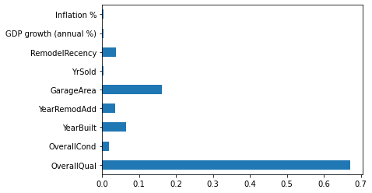
Best fit model:
Root Mean Squared Error: $42048.82
Notes:
The

Slide 9
The New “Essentials” of Reselling:
Overall Quality
Overall Condition
Year Built
Year Remodel Added
Years between Remodel and Sale
Garage Area
Inflation
GDP Growth

Slide 10
Conclusion:
The Random Forest model emerges as a clear winner.
GDP Growth has some impact, but not as strong of one as might be believed.
Remodeling is potentially valuable, but it sets a clock, as the remodel becomes extremely outdated in only one year.
Overall, risk is low, as the average price has not risen or fallen by more than about $10,000, and prices can easily rise within the space of a year. Simply ensure that the cost of remodeling does not exceed $10,000.

